Slide 1
60,000 Tests In Six Minutes
Creating A Reliable Pipeline, Eliminate Flaky Tests And Deploy Safely But Quickly
@MartinWoodward
Notes:
Martin Woodward digs into the testing transformation his team at Microsoft underwent and they started on their DevOps journey. He explains how they used to test their products and the issues (both technical and cultural) this presented and how they transformed to safely test in production.

Slide 2
Martin Woodward
@MartinWoodward
https://azure.com/devops
Join me in the Slack Channel for Q&A
#2018addo-cultrans
bit.ly/addo-slack

Slide 3





Azure DevOps
Continuous Delivery for Every Team, Every App, Every Platform
Azure Boards
Azure Pipelines
Azure Repos
Deliver value to your users faster using proven agile tools to plan, track, and discuss work across your teams.
Build, test, and deploy with CI/CD that works with any language, platform, and cloud. Connect to GitHub or any other Git provider and deploy continuously.
Get unlimited, cloud-hosted private Git repos and collaborate to build better code with pull requests and advanced file management.
Azure Test Plans
Azure Artifacts
➔
Test and ship with confidence using manual and exploratory testing tools.
Create, host, and share packages with your team, and add artifacts to your CI/CD pipelines with a single click.
https://azure.com/devops
Notes:
So does TFS

Slide 4
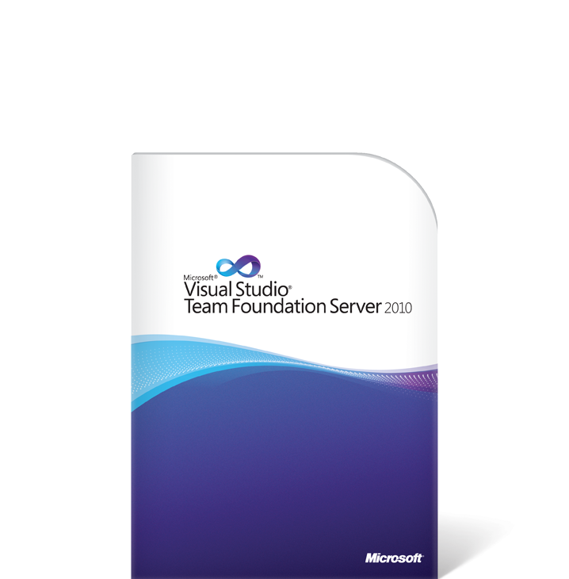
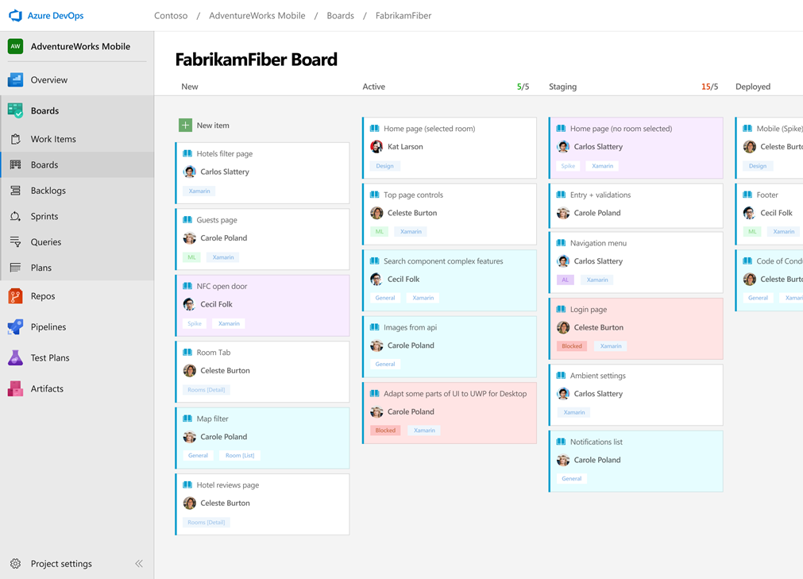
My Journey to DevOps
VSTS Preview
VSTS GA
1ES
Extensions
GVFS
Azure DevOps
Sprint 140
Sep 2018
Sprint 1
August 2010
Sprint 29
June 2012
Sprint 64
April 2014
Sprint 67
June 2014
Sprint 92
Nov 2015
Sprint 102
June 2016
2010
2011
2012
2013
2014
2015
2016
2017
2018

Slide 5
DevOps at Scale
Azure DevOps is the toolchain of choice for Microsoft engineering with over 90,000 internal users
➔
https://aka.ms/DevOpsAtMicrosoft
372k
Pull Requests per month
4.4m
Builds per month
5m
Work items viewed per day
78,000
Deployments per day
2m
Git commits per month
500m Test executions per day
500k
Work items updated per day
Data: Internal Microsoft engineering system activity, September 2018
Notes:
Enterprise scale

Slide 6
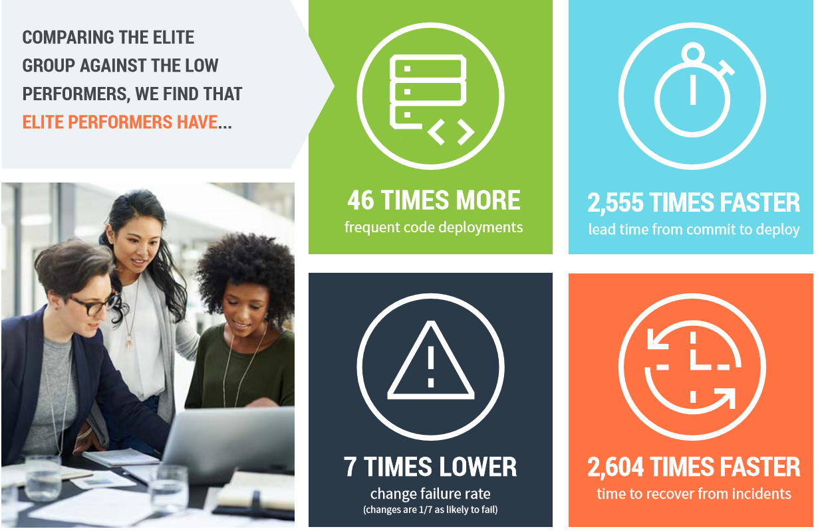

2018 State of DevOps Report Says…

Slide 7

What do you do about testing?
https://screeningfilm.com/events/shh-at-the-movies/
Notes:
There is a conspiracy of silence around

Slide 8
Some antipatterns from our past….
Developers threw code over the wall to test automation engineers
Test automation engineers threw test automation over the wall to testers
Outsourced testing as a functional silo to vendors
Split career tracks for devs and testers
Maintained test automation outside the code base
Relied on long-running, complex tests through the UI

Slide 9
Lesson learned:
Say
Nightly Automation Run
and your tests
will
take all night
Notes:
In fact ours were taking 22 hours…
And not a single run was green in 8 years of running them.

Slide 10
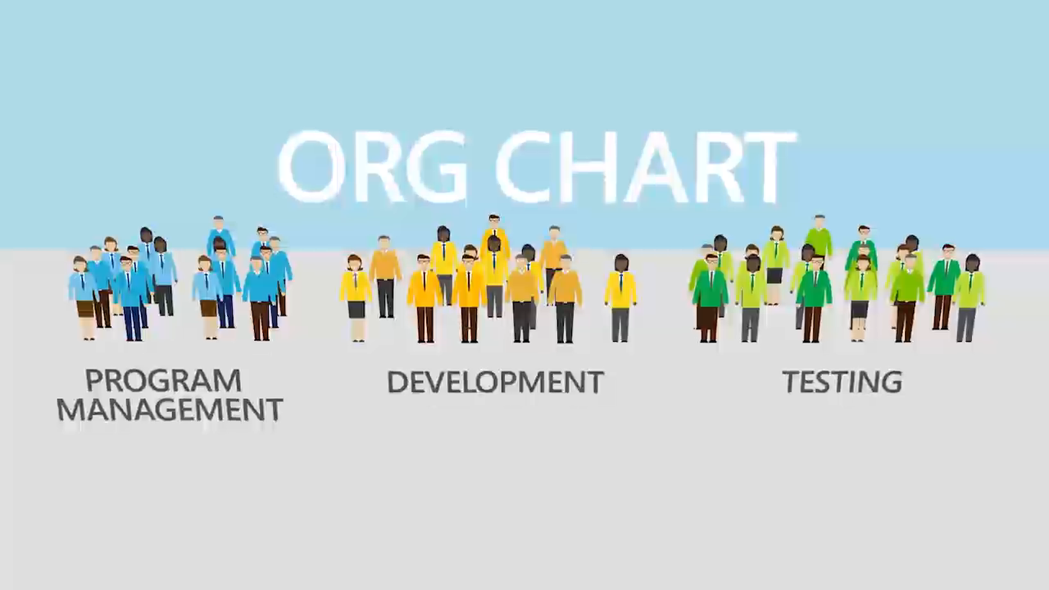

Slide 11
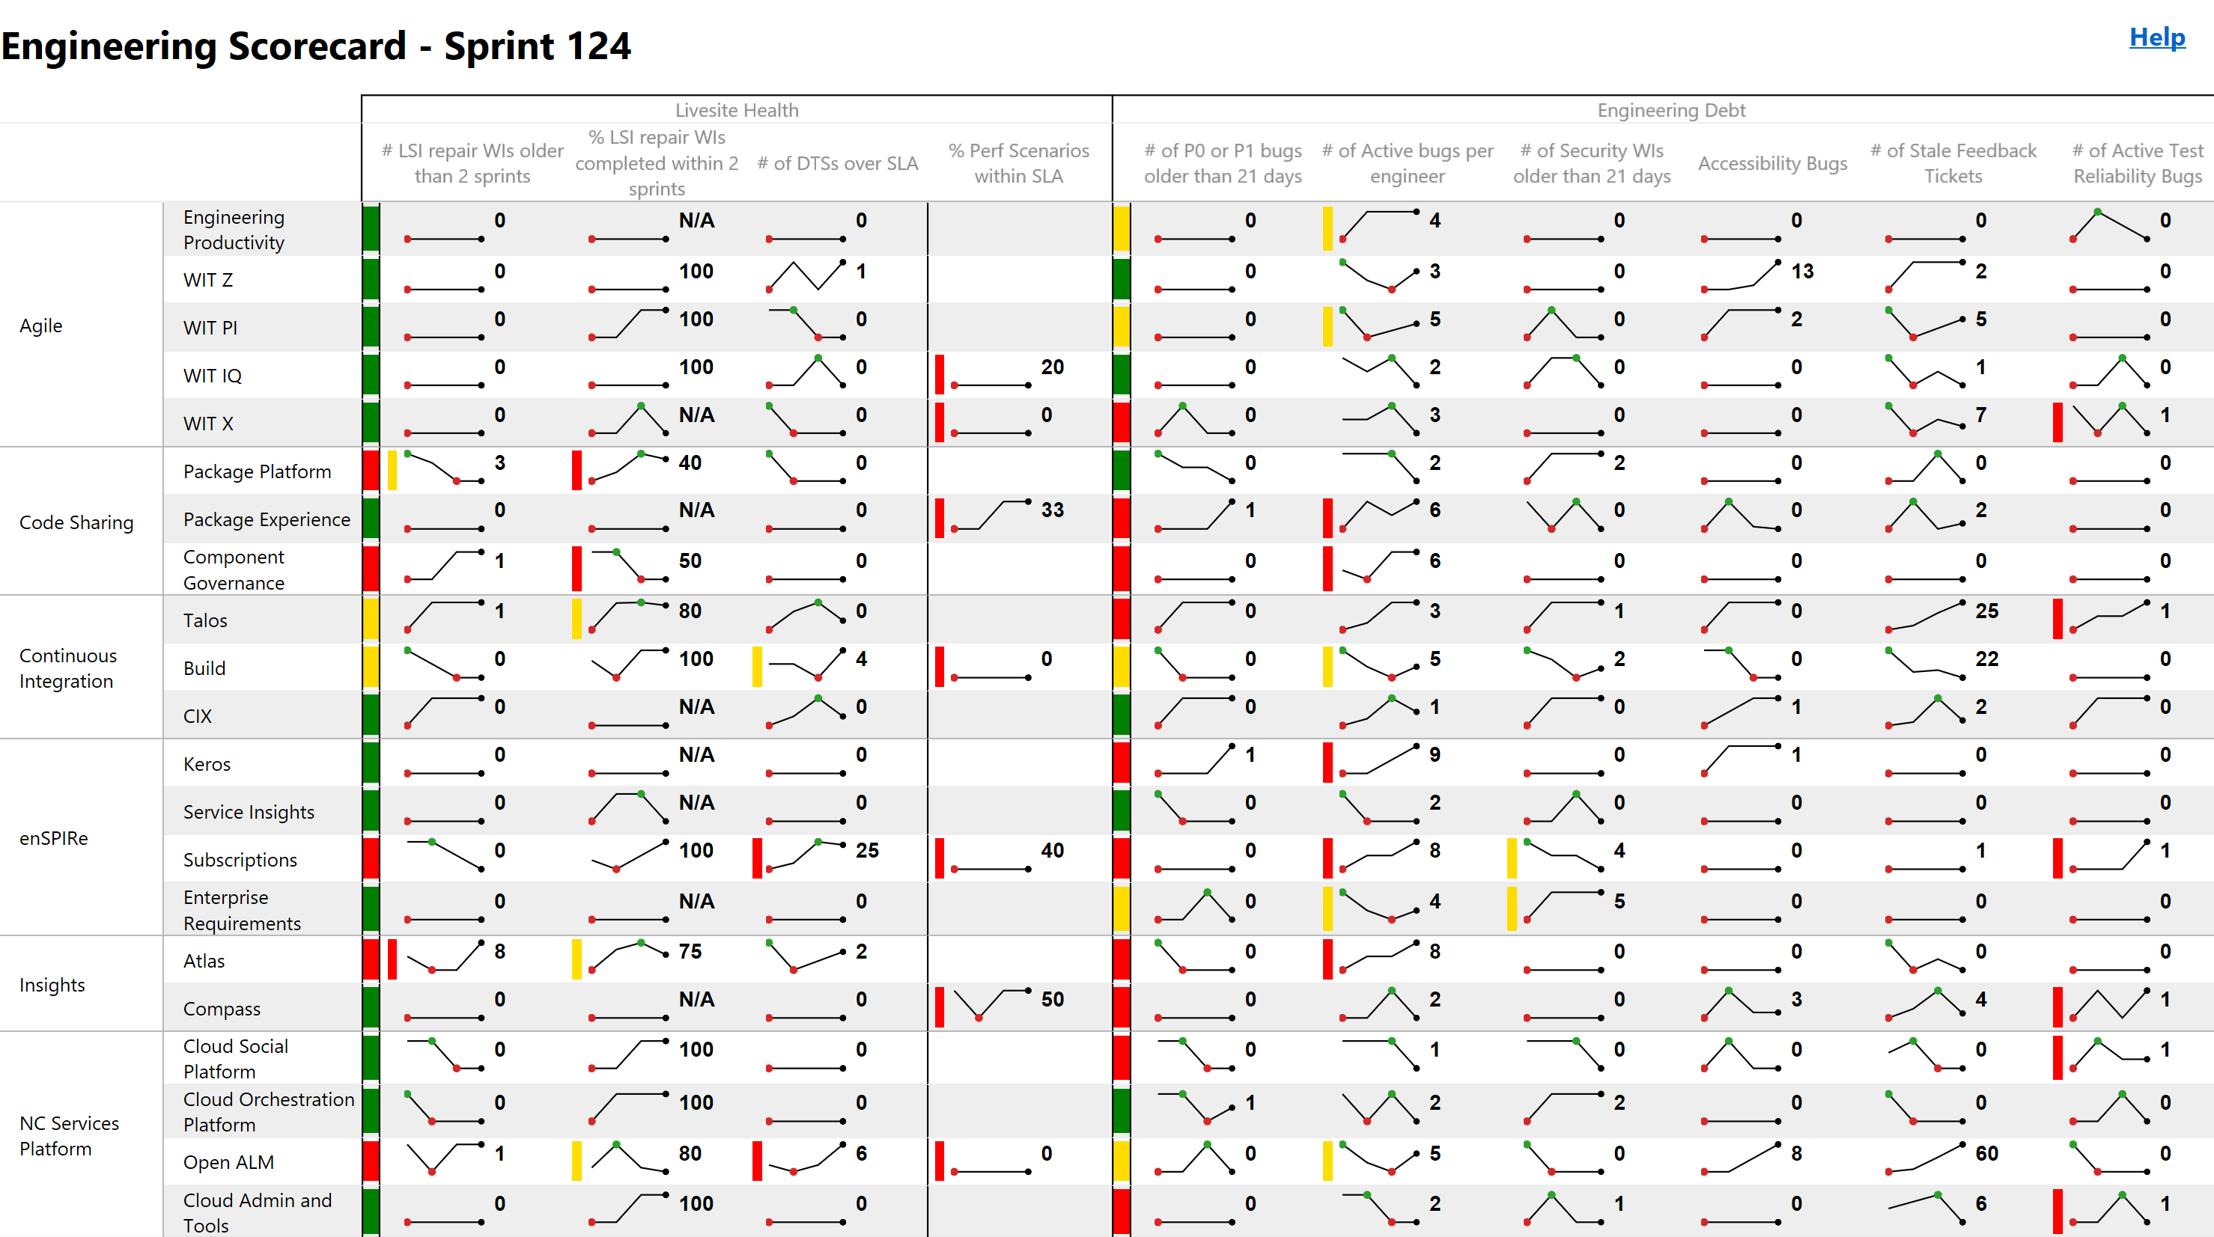
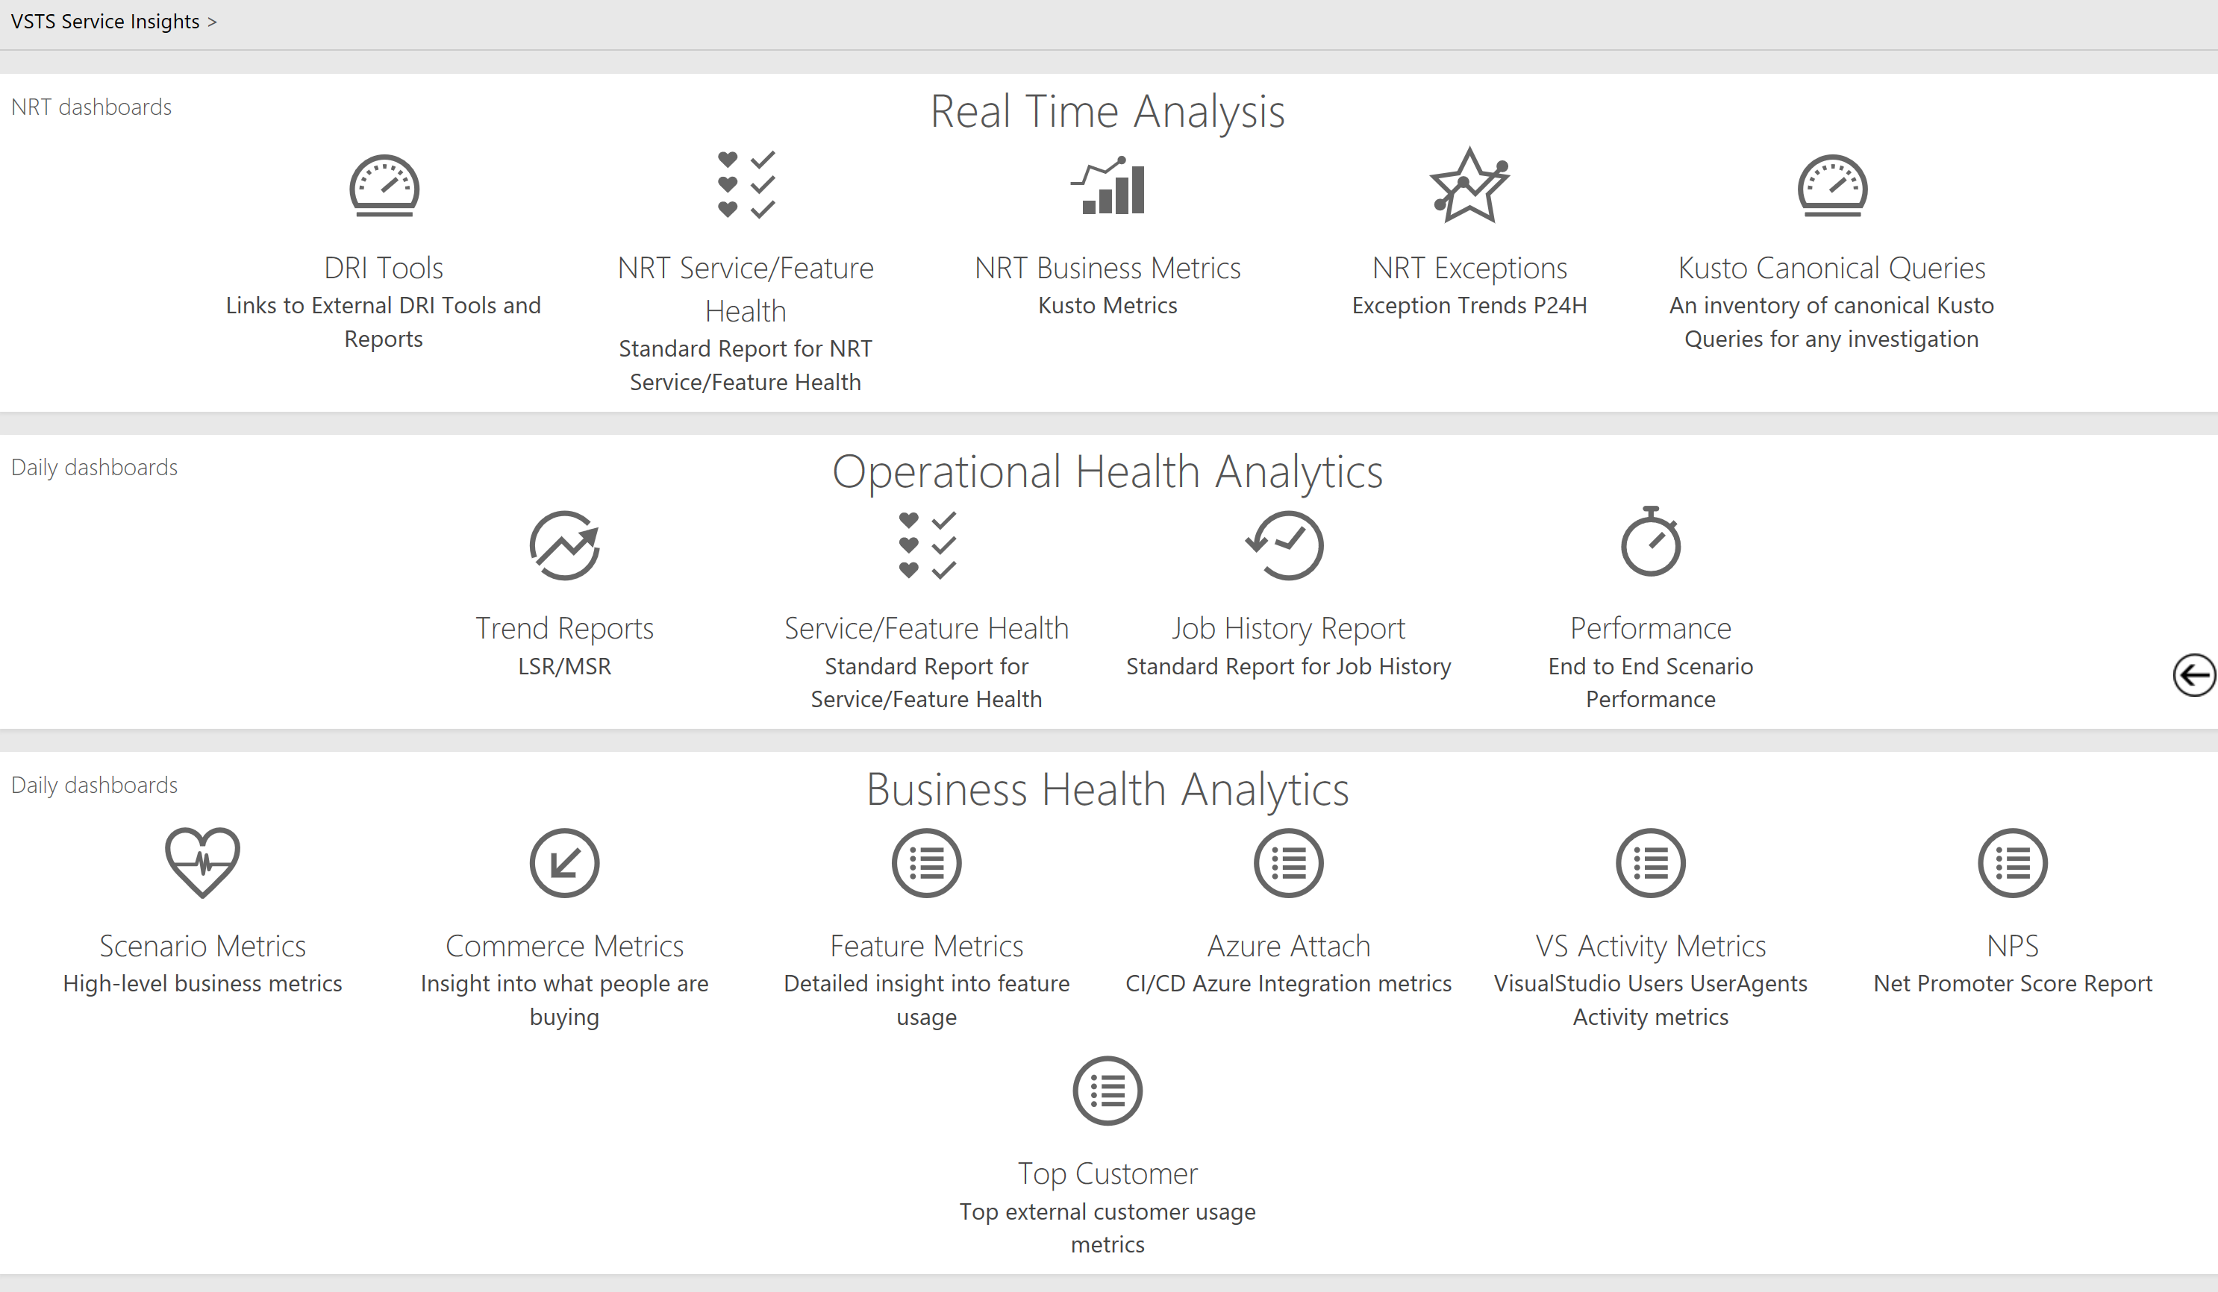
You get what you measure
Usage
Acquisition
Engagement
Satisfaction
Churn
Feature Usage
Live Site Health
Things we don’t watch
Time to Detect
Time to Communicate
Time to Mitigate
Which customers affected
Incident Prevention Items
Aging Prevention Items
SLA per Customer
Customer Support Metrics
Original estimate
Completed hours
Lines of Code
Team capacity
Team burndown
Team velocity
# of bugs found
% code coverage
Velocity
Time to Build
Time to Test
Time to Deploy
Time to Improve
Failed and flaky automation
Notes:
60% code coverage is roughly the magical number
Look at delta’s of code coverage
https://dev.azure.com/mseng/AzureDevOps/_apps/hub/epsteam.vstsscorecard-widget.VstsScorecardOverview.Hub

Slide 12

Azure DevOps Definition of Done
Live in production,
collecting telemetry,
supporting or diminishing the starting hypothesis.

Slide 13
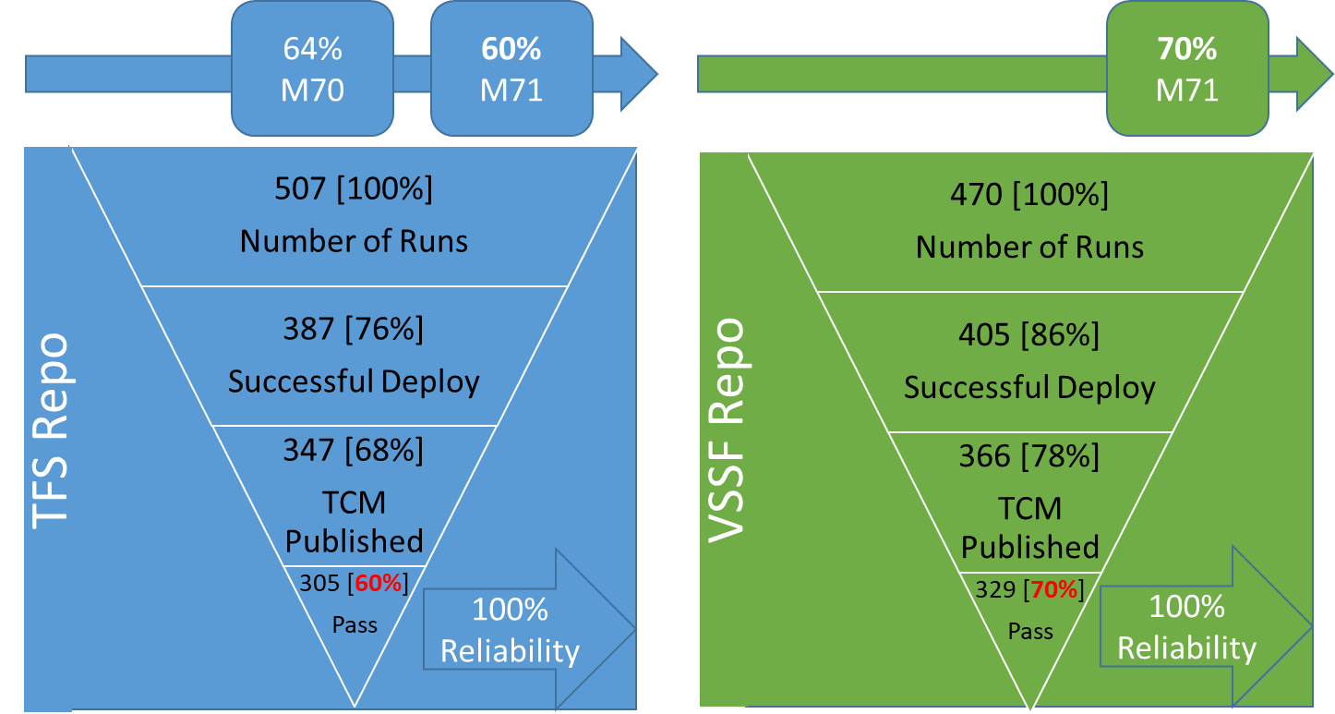
Our reality in Sept 2014
Tests took too long
Tests failed frequently
Quality signal unreliable in Master
Huge quality cliff to climb at the end of sprint
Notes:
Tests took too long
Nightly Automation Run (NAR): 22 hours
Full Automation Run (FAR) 2 days
Tests failed frequently
Only ~60% of P0 runs passed 100%
In 8 years, no NAR suite had run fully green
Quality signal unreliable in Master
Test failure analysis was too costly
Huge cliff to reach Release quality at the end of Sprint
Took days of human work to sift through failures before deployment could start

Slide 14

Everyone has an opinion
“purist”
“mockist”
Unit Tests? Bah!
Devs won’t take time to write them
Unit tests replace functional tests? That isn’t right.
Unit Tests? Finally!
Philosophical divide: “classical” and “mockist”
What do you mean?
Skip the partisan debate and move to the desired outcome
Unit tests are a design tool to achieve testability
You are responsible for your own quality
You get lightning fast, rock solid reliability wired into Pull Request flow
Acknowledge we need both unit and functional tests
Fowler: Mocks aren’t stubs provides balance between mockists and purists
Notes:
Lots of code in SQL (sprocs), how we going to test those.

Slide 15
Created a “Non-Denominational” Test Taxonomy
In-memory unit tests with no dependencies
Unit tests with dependencies e.g. SQL
Functional tests against APIs
PROD
L0
L1
L2
L3
In Pull Request
< 60 ms
< 2000 ms (avg 400 ms)
In pre-prod deployment, with mocked auth
In production rings

Slide 16
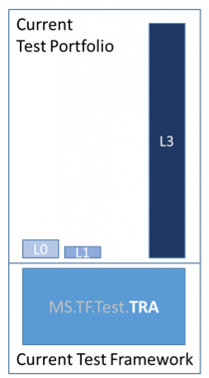
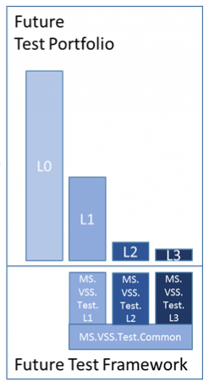
Excerpt from Feb 2015 Quality Vision
Principles
Tests should be written at the lowest level possible
Write once, run anywhere including production system
Product is designed for testability
Test code is product code, only reliable tests survive
Testing infrastructure is a shared Service
Test ownership follows product ownership

Slide 17

Shipping is a feature
Remember:
Notes:
Avoid the Tower of Babel
Don’t let the purists get you down

Slide 18
Shifting the test portfolio over time
Started with L0 / L1 tests
Made it easy to author and execute high quality L0/L1 tests
Stopped creating new legacy tests as much as possible
Analyzed legacy tests
Tests that can be deleted
Tests that can move to L0/L1
Tests that will move to VSSF Test SDK
On-prem tests we expect to maintain in lights-on mode
Port legacy to L2 tests
Test Arch v-team re-wrote L2 test framework
Top-down push from management with org wide scorecard
L3 tests
Use telemetry pipe
Carefully curated set
Notes:
TRA = Test Run Anywhere (old famework)

Slide 19
A journey of a thousand miles begins with a single sprint

Slide 20
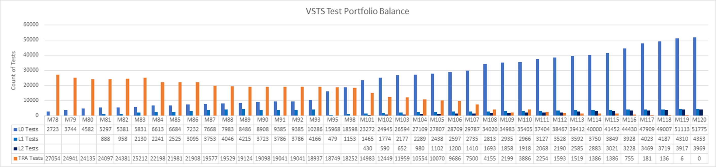
Sprint over sprint progress creating new and retiring old tests
L0 – Requires only built binaries, no dependencies
L1 – Adds ability to use SQL and file system
Run L0 & L1 in the pull request builds
L2 – Test a service via REST APIs
L3 – Full environment to test end to end
Notes:
Each sprint is 3 weeks. This took us 2.5 years to do…

Slide 21
Pull Requests > CI > Pre-Production Test runs at each level
Demo
Notes:
In progress PR -
Successful PR – have recent open in tab
L2 –

Slide 22

Left uncontrolled, non-deterministic tests can completely destroy the value of an automated regression suite.
“
”
Martin Fowler
https://martinfowler.com/articles/nonDeterminism.html

Slide 23
Finding flaky tests and fixing them
Reliability Bugs surfaced in Team scorecards
Reliability Run Workflow
Flakiness data automatically flows to official runs in real time
Flaky test are not quarantined; simply removed from the results
Reliability bugs fixed faster with clear visibility
Execute Reliability Runs on Green Builds
Tag Failed Tests as Flaky & file Reliability bugs
Aggregate Flaky tags over cumulative runs
Un-tag Flakiness when reliability bug is resolved
Azure Pipelines Extension tasks & Test Reporting Enhancements
Official Run Workflow
Execute Runs
Carry Flakiness from Latest Reliability run to current run
Flaky tests automatically re-run
Test Reporting enhancements
Notes:
Everynight run tests 500 times against the same build – does it pass 100%?

Slide 24
Flaky test detection
Demo
Notes:
https://dev.azure.com/mseng/AzureDevOps/_apps/hub/ms.vss-releaseManagement-web.cd-release-progress?_a=release-environment-extension&releaseId=6255460&environmentId=51078508&extensionId=ms.vss-test-web.test-result-in-release-environment-editor-tab

Slide 25

There’s no place like production

Slide 26
Your aim won’t be perfect. Control the blast radius.
4
3
2
1
0
Notes:
Progressive Exposure

Slide 27
Real-world Progressive Deployment
Demo
Notes:
Show release pipelines: https://dev.azure.com/mseng/AzureDevOps/_releaseDefinition?definitionId=121&_a=environments-editor-preview&view=mine
Feature flags

Slide 28
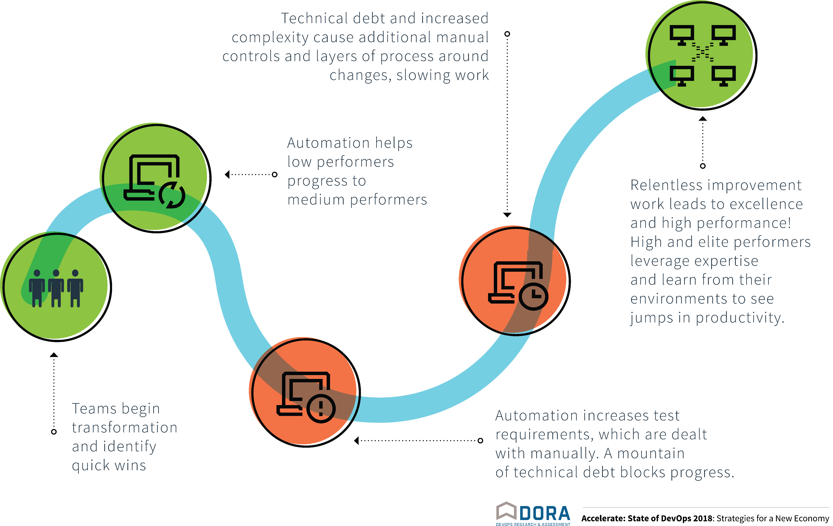
Progress follows a J-curve

Slide 29
Lessons we learned
Accountability can motivate culture change
Trunk-based development requires fast, reliable testing
Tests are code, are delivered with code and treated like code
Green means green, red means red
You’re not done until telemetry confirms you’re done
Change takes time – but you won’t get there unless you start

Slide 32
Thank you!
Join me in the Slack Channel for Q&A
#2018addo-cultrans
bit.ly/addo-slack
Martin Woodward
@MartinWoodward
https://azure.com/devops
Notes:
Next up Uldis from Accenture talking about leading a DevOps team.

Slide 34
Azure DevOps: Millions of users + Most of Microsoft
Data: Internal Microsoft engineering system activity, September 2018

Slide 35
Make them fast: progress by Sept 2017
Source: Internal Test Execution Time, September 2017
Level 0
Execution: 6:00 mins
Total Tests: 55,411
Number of Assemblies: 2104
Level 1
Execution: 3:30 mins
Total Tests: 4,647
Number of Assemblies: 41

